Slide 1
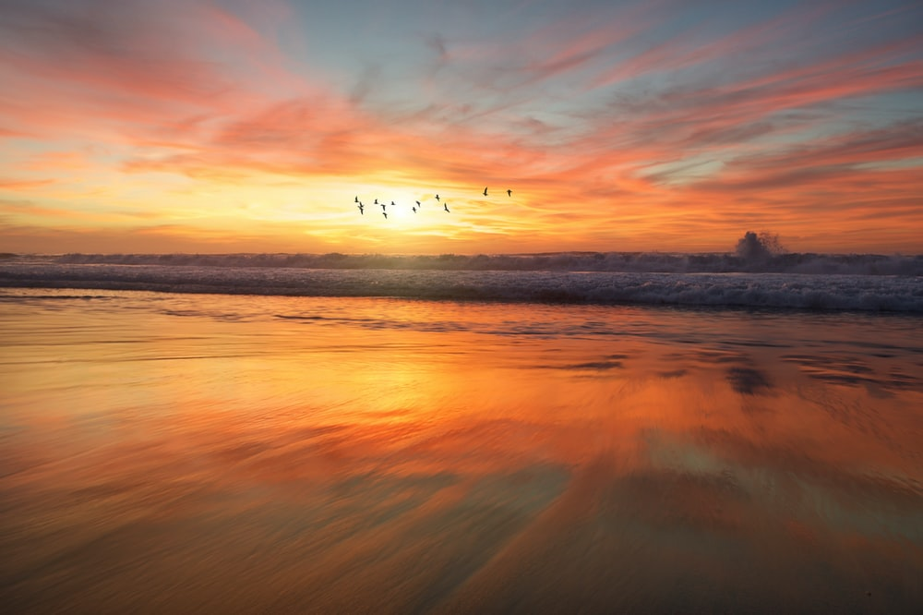
THANKSGIVING: The Heart of Stewardship

Slide 2
Chorus
He owns the cattle on a thousand hills The wealth in every mine, He owns the rivers and the rocks and rills, The sun and stars that shine,
Wonderful riches more than tongue can tell He is my Father so they’re mine as well He owns the cattle on a thousand hills And I know He cares for me.

Slide 3
Psalm 50:7-13
“Hear, O my people, and I will speak; O Israel, and I will testify against thee: I am God, even thy God. I will not reprove thee for thy sacrifices or thy burnt offerings, to have been continually be‐ fore me. I will take no bullock out of thy house, nor he goats out of thy folds […]
[…] For every beast of the forest is mine, and the cattle upon a thousand hills. I know all the fowls of the mountains: and the wild beasts of the field are mine. If I were hungry, I would not tell thee: for the world is mine, and the fulness thereof. Will I eat the flesh of bulls, or drink the blood of goats?”

Slide 4
Psalm 50:14
“Offer unto God thanksgiving; and pay thy vows unto the most High:”

Slide 5
Psalm 50:23
“Whoso offereth praise glorifieth me: and to him that ordereth his conversation aright will I shew the salvation of God.”
Psalm 50:23 ESV
“The one who offers thanksgiving as his sacrifice glorifies me; to one who orders his way rightly I will show the salvation of God!”

Slide 6
Psalm 95:1-7, 8a
“Let us come before his presence with thanksgiving, and make a joyful noise unto him with psalms. For the LORD is a great God, and a great King above all gods. In his hand are the deep places of the earth: the strength of the hills is his also [...]
[…] The sea is his, and he made it: and his hands formed the dry land. O come, let us wor‐ ship and bow down: let us kneel before the LORD our maker. For he is our God; and we are the people of his pasture, and the sheep of his hand. To day if ye will hear his voice, Harden not your heart.”

Slide 7
A Creator Who Cares

Slide 8
Psalm 95:6
“O come, let us worship and bow down: let us kneel before the LORD our maker.”

Slide 9
Psalm 100:3
“[God] hath made us, and not we our‐ selves; we are his people, and the sheep of his pasture.”

Slide 10
Medical Ministry, p. 8.
“The Lord has given His life to the trees and vines of His creation. His word can in‐ crease or decrease the fruit of the land. If men would open their understanding to discern the relation between nature and nature’s God, faithful acknowledgments of the Creator’s power would be heard. With‐ out the life of God, nature would die […]”

Slide 11
Medical Ministry, p. 8.
“[…] His creative works are dependent on Him. He bestows life-giving properties on all that nature produces. We are to regard the trees laden with fruit as the gift of God, just as much as though He placed the fruit in our hands.”

Slide 12
Matthew 5:45
“That ye may be the children of your Father which is in heaven: for he maketh his sun to rise on the evil and on the good, and sendeth rain on the just and on the unjust.”

Slide 13
Luke 9:17
“And they did eat, and were all filled: and there was taken up of fragments that remained to them twelve baskets.”

Slide 14
The Desire of Ages, p. 367.
“In feeding the five thousand, Jesus lifts the veil from the world of nature, and reveals the power that is constantly exercised for our good. In the production of earth’s harvests, God is working a miracle every day […]”

Slide 15
The Desire of Ages, p. 367.
“[…] Through natural agencies the same work is accomplished that was wrought in the feeding of the multitude. Men prepare the soil and sow the seed, but it is the life from God that causes the seed to germinate […]”

Slide 16
The Desire of Ages, p. 367.
“[…] It is God’s rain and air and sunshine that cause it to put forth ‘first the blade, then the ear, after that the full corn in the ear.’ It is God who is every day feeding millions from earth’s harvest fields.”

Slide 17
Colossians 1:16
“For by him were all things created, that are in heaven, and that are in earth,…all things were created by him, and for him.”

Slide 18
Colossians 1:17
“[…] and by him all things consist.”

Slide 19
Hebrews 1:3
“[Jesus] upholding all things by the word of his power.”

Slide 20
Medical Ministry, p. 8.
“The beating heart, the throbbing pulse, every nerve and muscle in the living organism, are kept in order and activity by the power of an infinite God.”

Slide 21
Matthew 6:28
“And why take ye thought for raiment? Consider the lilies of the field, how they grow; they toil not, neither do they spin:”

Slide 22
Matthew 6:29
“And yet I say unto you, That even Solomon in all his glory was not arrayed like one of these.”

Slide 23
Matthew 6:30
“Wherefore, if God so clothe the grass of the field, which today is, and to morrow is cast into the oven, shall he not much more clothe you, O ye of little faith?”

Slide 24
Matthew 6:31
“Therefore take no thought, saying, What shall we eat? or, What shall we drink? or, Wherewithal shall we be clothed?”

Slide 25
Matthew 6:32
“(For after all these things do the Gentiles seek:) for your heavenly Father knoweth that ye have need of all these things.”

Slide 26
Matthew 6:33
“But seek ye first the kingdom of God, and his righteousness; and all these things shall be added unto you.”

Slide 27
Medical Ministry, p. 9.
“Here Christ leads the mind abroad to contemplate the open fields of nature, and His power touches the eye and the senses, to discern the wonderful works of divine power. He directs attention first to nature, then up through nature to nature’s God, who upholds the worlds by His power.”

Slide 28
A Creator Who Gives

Slide 29
James 1:17
“Every good gift and every perfect gift is from above, and cometh down from the Father of lights, with whom is no variableness, neither shadow of turning.”

Slide 30
The Desire of Ages, p. 20
“In the beginning, God was revealed in all the works of creation.... And upon all things in earth, and air, and sky, He wrote the message of the Father’s love.”

Slide 31
Faith and Works, p. 21.
“This was the position of the human race after man divorced himself from God by transgression. Then he was no longer entitled to a breath of air, a ray of sunshine, or a particle of food.”

Slide 32
He Gave Himself

Slide 33
John 3:16
“For God so loved the world, that he gave his only begotten Son, that whoso‐ ever believeth in him should not perish, but have everlasting life.”

Slide 34
1 Timothy 2: 5, 6
“For there is one God, and one mediator between God and men, the man Christ Je‐ sus; Who gave himself a ransom for all, to be testified in due time.”

Slide 35
God’s Amazing Grace, p. 190.
“It is the glory of the gospel that it is founded upon the principle of restoring in the fallen race the divine image by a constant manifestation of benevolence […]”

Slide 36
God’s Amazing Grace, p. 190.
“[…] This work began in the heavenly courts.... The Godhead was stirred with pity for the race, and the Father, the Son, and the Holy Spirit gave themselves to the working out of the plan of redemption.”

Slide 37
Romans 8:32
“He that spared not his own Son, but de‐ livered Him up for us all, how shall He not with him also freely give us all things?”

Slide 38
2 Corinthians 9:15
“Thanks be unto God for His unspeakable gift,”

Slide 39
The Message of Love in Nature

Slide 40
The Desire of Ages, p. 20.
“Even now all created things declare the glory of His excellence.... Every tree and shrub and leaf pours forth that element of life without which neither man nor animal could live; and man and animal, in turn, minister to the life of tree and shrub and leaf.”

Slide 41
The Desire of Ages, p. 21.
“But turning from all lesser representations, we behold God in Jesus. Looking unto Jesus we see that it is the glory of our God to give. ‘I do nothing of My‐ self,’ said Christ; ‘the living Father hath sent Me, and I live by the Father.’ ‘I seek not Mine own glory,’ but the glory of Him that sent Me. John 8:28; 6:57; 8:50; 7:18 […]”

Slide 42
The Desire of Ages, p. 21.
“[…] In these words is set forth the great principle which is the law of life for the universe. All things Christ received from God, but He took to give. So in the heavenly courts, in His ministry for all created beings: through the beloved Son, the Father’s life flows out to all; through the Son it returns, in praise and joyous service, a tide of love, to the great Source of all […]”

Slide 43
The Desire of Ages, p. 21.
“[…] And thus through Christ the circuit of beneficence is complete, representing the character of the great Giver, the law of life.”

Slide 44
Completing the Circuit

Slide 45
Titus 2:14
“Who gave himself for us, that he might redeem us from all iniquity, and purify unto himself a peculiar people, zealous of good works.”

Slide 46
Food for Thought
All iniquity means “every lawless deed” (NKJV) or “all lawlessness” (ESV).
Since God’s law is “love” (Romans 13:10), to be redeemed from “every lawless deed” means we are delivered from every loveless deed.

Slide 47
2 Corinthians 5: 14, 15
“For the love of Christ constraineth us; because we thus judge, that if one died for all, then were all dead: And that he died for all, that they which live should not henceforth live unto themselves, but unto him which died for them, and rose again.”

Slide 48
The Desire of Ages, p. 195.
“Every true disciple is born into the kingdom of God as a missionary. He who drinks of the living water becomes a fountain of life. The receiver becomes a giver. The grace of Christ in the soul is like a spring in the desert, welling up to refresh all, and making those who are ready to perish eager to drink of the water of life.”

Slide 49
Acts 20:28
“Take heed therefore unto yourselves, and to all the flock, over the which the Holy Ghost hath made you overseers, to feed the church of God, which he hath purchased with his own blood.”

Slide 50
Faith and Works, p. 22.
“Now every member of the human family is given wholly into the hands of Christ, and whatever we possess— whether it is the gift of money, of houses, of lands, of reasoning powers, of physical strength, of intellectual talents—in this present life, and the blessings of the future life, are placed in our possession as God’s treasures to be faithfully […]”

Slide 51
Faith and Works, p. 22.
“[…] expended for the benefit of man. Every gift is stamped with the cross and bears the image and superscription of Jesus Christ. All things come of God. From the smallest benefits up to the largest blessing, all flow through the one Channel—a superhuman mediation sprinkled with the blood that is of value beyond estimate because it was the life of God in His Son.”

Slide 52
Faith and Works, p. 22.
“Now not a soul can give God anything that is not already His. Bear this in mind: ‘All things come of Thee, and of Thine own have we given Thee’ (1 Chronicles 29:14) [...]”

Slide 53
Faith and Works, p. 22.
“[…] This must be kept before the people wherever we go—that we possess nothing, can offer nothing in value, in work, in faith, which we have not first received of God and upon which He can lay His hand any time and say, They are Mine—gifts and blessings and endowments I entrusted to you, not to enrich yourself, but for wise improvement to benefit the world.”

Slide 54
The Blessing of Property

Slide 55
Think about it
Why God blesses us with property?

Slide 56
The Acts of the Apostles, p. 75.
“It is God who blesses men with property, and He does this that they may be able to give toward the advancement of His cause.”

Slide 57
1 Chronicles 29:12
“Both riches and honour come of thee, and thou reignest over all; and in thine hand is power and might; and in thine hand it is to make great, and to give strength unto all.”

Slide 58
1 Chronicles 29:13
“Now therefore, our God, we thank thee, and praise thy glorious name.”

Slide 59
1 Chronicles 29:14
“But who am I, and what is my people, that we should be able to offer so willingly after this sort? for all things come of thee, and of thine own have we given thee.”

Slide 60
Gratitude in Action

Slide 61
Psalm 116:12
“What shall I render unto the LORD for all his benefits toward me?”

Slide 62
Psalm 116:13
“I will take the cup of salvation, and call upon the name of the LORD.”

Slide 63
Psalm 116:14
“I will pay my vows unto the LORD now in the presence of all his people.”

Slide 64
Think about it
How do we show gratitude to God beyond our words or music?

Slide 65
The Acts of the Apostles, p. 75.
“[God] sends the sunshine and the rain. He causes vegetation to flourish. He gives health and the ability to acquire means. All our blessings come from His bountiful hand […]”

Slide 66
The Acts of the Apostles, p. 75.
“[…] In turn, He would have men and women show their gratitude by returning Him a portion in tithes and offerings—in thank offerings, in freewill offerings, in trespass offerings [...]”

Slide 67
The Acts of the Apostles, p. 75.
“[…] Should means flow into the treasury in accordance with this divinely appointed plan,—a tenth of all the increase, and liberal offerings,—there would be an abundance for the advancement of the Lord’s work.”

